Slide 1
Week 7, 1F
Rishab Ketan Doshi

Slide 2
Announcements
Midterm grades to be released today
Project 0 and 1a grades to should be out by now

Slide 3
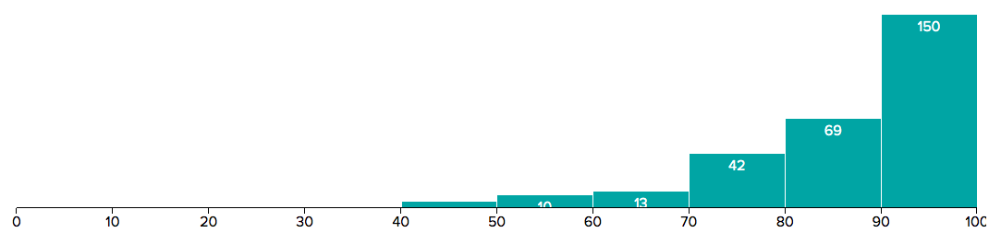
Midterm statistics
MEDIAN: 90.5%
MAXIMUM: 100.0%
MEAN: 86.22%
STD DEV: 12.47%

Slide 4
Project 4b
Due next wednesday
Continuation of Project 4a
In this project we will create applications
that run in an embedded system
read data from external sensors
and log the results.
Real world devices of this kind are commonly networked. We'll take that step in Project 4C. For now, the device you build will be stand-alone.

Slide 5
Project 4b - Overview
Connect Grove Temperature Sensor and Grove Button to your Beaglebone
Read values from the grove temperature sensor periodically
Outputs temperature details to stdout and a logfile
Read and interpret commands from the user to control sampling

Slide 6
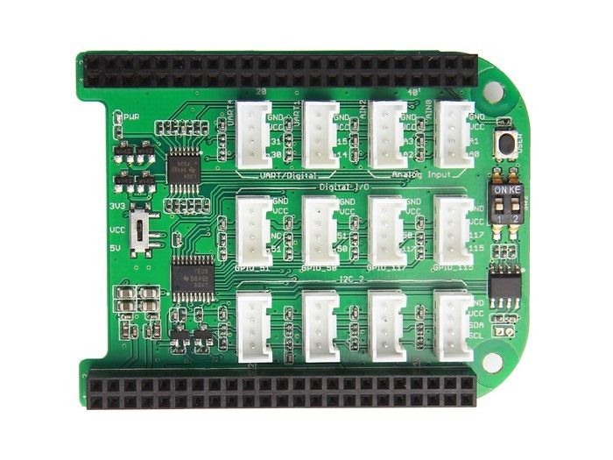
How to connect Grove temperature sensor?
Attach the Grove Temperature Sensor to Analog A0/A1 connector on your Grove cape

Slide 7
How to control the temperature sensor?
Attach the Grove Button to the GPIO_50 connector on your Grove cape

Slide 8
MRAA Library
Low Level Skeleton Library for Communication on GNU/Linux platforms
MRAA is a C library that provides an Application Programming Interface (API) to establish a method of communication between compute modules (such as the BeagleBone) and other peripheral devices (such as sensors).
The BeagleBone and the MRAA library support a number of protocols including:
Universal Asynchronous Receiver/Transmitter (UART)
Inter-integrated Circuit (I2C) Pulse Width Modulation (PWM)
General Purpose Input/Output (GPIO) programming.
Notes:
Src: https://drive.google.com/drive/folders/0B6dyEb8VXZo-N3hVcVI0UFpWSVk

Slide 9
GPIO
The BeagleBone has pins dedicated to different protocols (PWM, UART, I2C, etc). However, there are cases where a sensor or peripheral device will not use a standard protocol such as I2C or SPI. For this we use GPIO.
We will use GPIO pins to
Detect a button push that prompts us to stop sampling the temperature and exit the program.

Slide 10
AIO
We will use analog input output pins to read analog signal values from the Grove temperature sensor.

Slide 11
Project 4b requirements
Write a program (called lab4b) that:
builds and runs on your embedded system.
uses the AIO functions of the MRAA library to get readings from your temperature sensor.
samples a temperature sensor at a configurable rate (defaulting to 1/second, and controlled by an optional --period=# command line parameter that specifies a sampling interval in seconds).
converts the sensor value into a temperature. By default, temperatures should be reported in degrees Fahrenheit, but this can be controlled with an optional --scale=C (or --scale=F) command line parameter.
creates a report for each sample that includes:
time of the sample (e.g. 17:25:58) in the local timezone
a single blank/space
a decimal temperature in degrees and tenths (e.g. 98.6)
a newline character (\n)
writes that report to the stdout (fd 1).
appends that report to a logfile (which it creates on your embedded system) if that logging has been enabled with an optional --log=filename parameter.
uses the GPIO functions of the MRAA library to sample the state of the button (from your Grove sensor kit) and when it is pushed ...
outputs (and logs) a final sample with the time and the string SHUTDOWN (instead of a temperature).
exits
Your program can assume that the sensors are connected as recommended by the Grove documentation.

Slide 12
Reading temperature values from Grove
There are readymade programs and functions in python, c that give access to temperature, humidity values from the sensor.
Example here
However the spec wants you to use MRAA AIO/GPIO functions to access your sensors, and not the (more powerful and convenient) Grove library functions. The Grove library hides all of the details of embedded I/O, sampling and signal interpretation, but only works for the Grove Sensors.
Working with lower level APIs will give you experience with direct control of and access to the digital and analog I/O pins.
Notes:
https://github.com/DexterInd/GrovePi/blob/master/Software/Cpp/grove_dht_pro/grove_dht_example.cpp

Slide 13
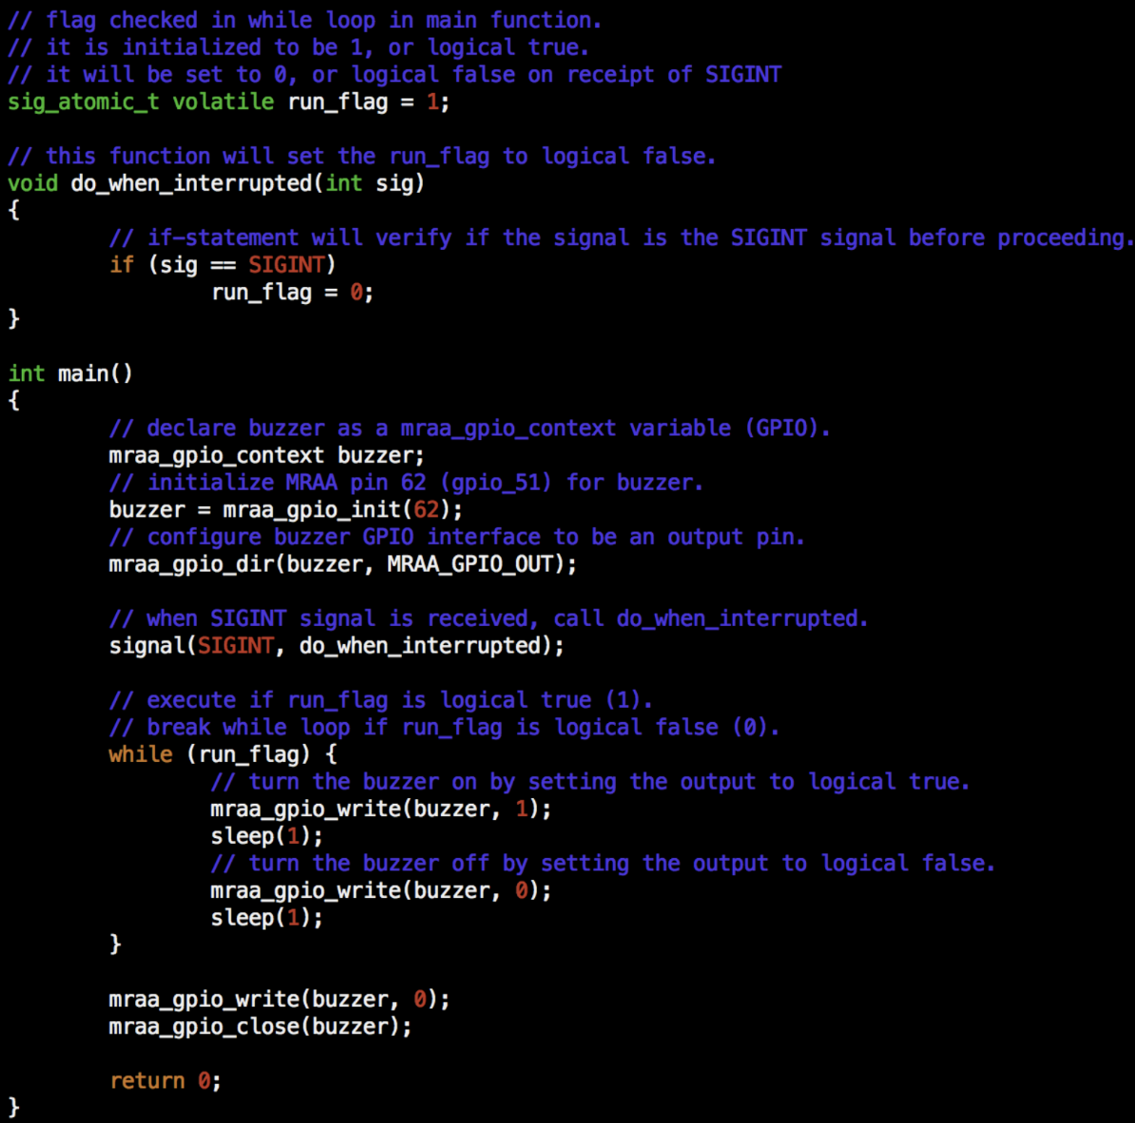
Sample program
This program emits a beep sound using a buzzer until the user presses Ctrl+C.

Slide 14
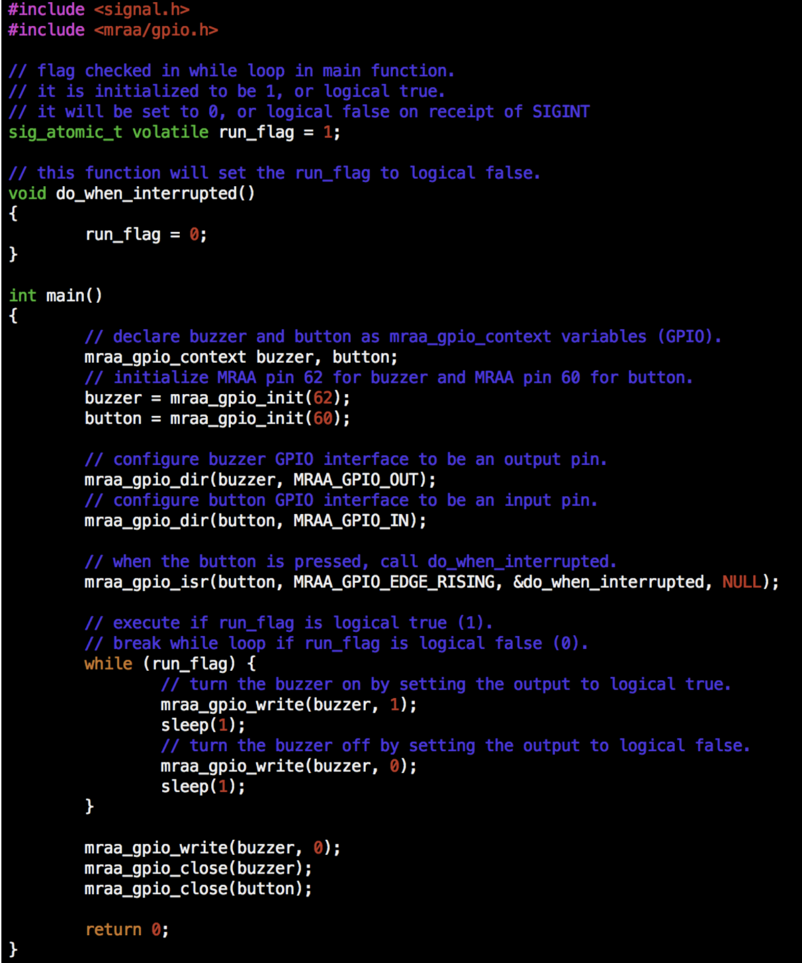
Sample program
This program emits a beep sound until the user presses the button.

Slide 15
MRAA functions/variables to unpack
mraa_gpio_init
mraa_gpio_dir
mraa_gpio_close
mraa_gpio_context

Slide 16
mraa_gpio_context
/**
* Opaque pointer definition to the internal struct _gpio
*/
typedef struct _gpio* mraa_gpio_context;
This context is initialized by the mraa library based on the underlying hardware being used.
MRAA works across many platforms and has bindings for each of them. The gpio_context allows us to perform various functions like read from the sensors, write to the sensors, close the I/O to the sensor.

Slide 17
mraa_gpio_init
/**
* Initialise gpio_context, based on board number
*
* @param pin Pin number read from the board, i.e IO3 is 3
* @returns gpio context or NULL
*/
mraa_gpio_context mraa_gpio_init(int pin);
Pins on the board have a number mapping.
Identify the pin number corresponding to the button that you are connecting.

Slide 18
mraa_gpio_dir
/**
* Gpio Direction options
*/
typedef enum {
MRAA_GPIO_OUT = 0, /**< Output. A Mode can also be set */
MRAA_GPIO_IN = 1, /**< Input */
MRAA_GPIO_OUT_HIGH = 2, /**< Output. Init High */
MRAA_GPIO_OUT_LOW = 3 /**< Output. Init Low */
} mraa_gpio_dir_t;
/**
* Set Gpio(s) direction
*
* @param dev The Gpio context
* @param dir The direction of the Gpio(s)
* @return Result of operation
*/
mraa_result_t mraa_gpio_dir(mraa_gpio_context dev, mraa_gpio_dir_t dir);
We will use mraa_gpio_dir to read the button input.
Identify which of these direction values we want to detect a button push.
The mraa_gpio_context used here is the one we get on creating the button context by using mraa_gpio_init with button pin mapping

Slide 19
mraa_gpio_close
/**
* Close the Gpio context
* - Will free the memory for the context and unexport the Gpio - sysfs interface.
* - Will free up the memory used by context and close related file descriptors - chardev interface.
*
* @param dev The Gpio context
* @return Result of operation
*/
mraa_result_t mraa_gpio_close(mraa_gpio_context dev);
Once we are done with sampling and are going to shut down, we need to close the GPIO interface to the button.
So the button context that was present needs to be passed to the mraa_gpio_close function

Slide 20
mraa_gpio_read
/**
* Read the Gpio value. This can be 0 or 1. A response of -1 means that there
* was a fatal error.
*
* @param dev The Gpio context
* @return Result of operation
*/
int mraa_gpio_read(mraa_gpio_context dev);
To detect the button push, we used the GPIO interrupts in the sample programs.
Alternatively, we can use the
mraa_gpio_read function to read the gpio input from the button context.
Identify the return value of the function mraa_gpio_read when the button is pushed.

Slide 21
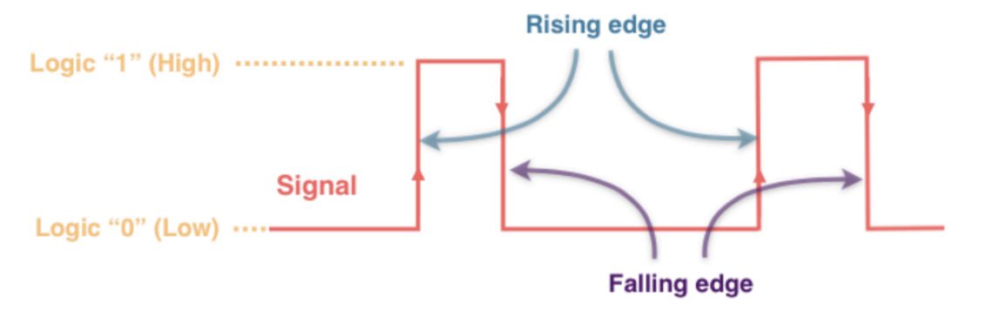
Button Input / Output - Discrete

Slide 22
Analog Input / Output
We have used the gpio input output interface to detect changes to the button state. However, the temperature sensor readings are not necessarily discrete values.
These readings can have multiple different values and is an analog signal.
We can use the mraa/aio.h header file to access functions specific to analog input output.

Slide 23
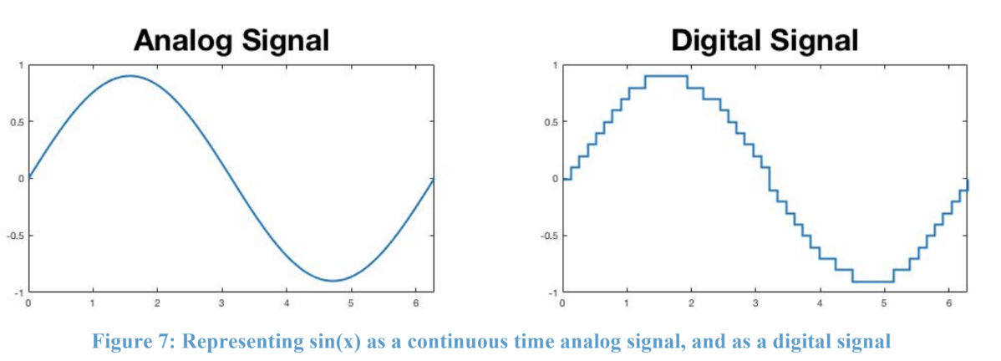
Converting Analog to Digital Signal

Slide 24
mraa_aio_context
Context used to represent analog input output
/**
* Opaque pointer definition to the internal struct _aio. This context refers
* to one single AIO pin on the board.
*/
typedef struct _aio* mraa_aio_context;
We will use the mraa_aio_context to interface with the temperature sensor

Slide 25
mraa_aio_init
/**
* Initialise an Analog input device, connected to the specified pin. Aio pins
* are always 0 indexed reguardless of their position. Check your board mapping
* for details. An arduino style layout will have A0 as pin14 but AIO0.
*
* @param pin Channel number to read ADC inputs
* @returns aio context or NULL
*/
mraa_aio_context mraa_aio_init(unsigned int pin);
Identify the pin number for the temperature sensor. Initialize the aio context using that pin number

Slide 26
mraa_aio_read
/**
* Read the input voltage. By default mraa will shift the raw value up or down
* to a 10 bit value.
*
* @param dev The AIO context
* @returns The current input voltage or -1 for error
*/
int mraa_aio_read(mraa_aio_context dev);
We use this value to calculate the temperature readings from the sensor.
The context to be passed to the read function is the one we use to create the mraa_aio_context for the temperature sensor

Slide 27
mraa_aio_close
/**
* Close the analog input context, this will free the memory for the context
*
* @param dev The AIO context
* @return Result of operation
*/
mraa_result_t mraa_aio_close(mraa_aio_context dev);
Use this to close the interface to the temperature sensor. This is to be done when we want to shutdown the program.
The context to be passed to the read function is the one we use to create the mraa_aio_context for the temperature sensor.

Slide 28
Aside - Calculating Temperature
int a = analogRead(pinTempSensor);
float R = 1023.0/a-1.0;
R = R0*R;
float temperature = 1.0/(log(R/R0)/B+1/298.15)-273.15; // convert to temperature via datasheet
Serial.print("temperature = ");
Serial.println(temperature);
This is from the grove temperature sensor manual.
The temperature is calculated as a function of the change in resistance value of the thermistor.
This is also dependent on the B value which changes with the thermistor.
Identify the B value of your sensor
analogRead can be replaced with which of the MRAA functions?
Notes:
Reference: http://wiki.seeedstudio.com/Grove-Temperature_Sensor_V1.2/

Slide 29
Aside - Converting from Celsius to Fahrenheit
Temperature (Fahrenheit) = (Temperature in Celsius * 9)/5 + 32
In the previous step we calculated the temperature value in celsius.
If the specified scale is fahrenheit, use the formula above.
Ensure you use the right data types across conversions.
Be sure to include the math header file for log calculation(previous slide)

Slide 30
Implementing 4b
Accept below options from user :-
Period -
specifies the sampling frequency for the temperature readings
This will dictate how often we perform the read of the analog signals
Scale -
Celsius or Fahrenheit
Pass scale as C or F
Log - The log file to be created for reporting temperatures read and subsequently logging commands received

Slide 31
Implementing 4b - commands
Accept commands from the user while the program is running.
Poll on the STDIN to see if any new commands have been provided.
All received commands will be terminated by a new-line character ('\n').
Note that when your program is tested (by the sanity checker or grading program) stdin will not be a console, but a pipe. A single read may return a partial line or multiple lines. Make sure that your program buffers and lexes its input, and does not assume that one call to read(2) will return one command.

Slide 32
Commands to be supported
SCALE=F This command should cause all subsequent reports to be generated in degrees Fahrenheit.
SCALE=C This command should cause all subsequent reports to be generated in degrees Centegrade
PERIOD=seconds This command should change the number of seconds between reporting intervals. It is acceptable if this command does not take effect until after the next report.
STOP This command should cause the program to stop generating reports, but continue processing input commands. If the program is not generating reports, merely log receipt of the command.
START This command should cause the program to, if stopped, resume generating reports. If the program is not stopped, merely log receipt of the command.
LOG line of text This command requires no action beyond logging its receipt (the entire command, including the LOG). In project 4C, the server may send such commands to help you debug problems with your reports.
OFF This command should, like pressing the button, output (and log) a time-stamped SHUTDOWN message and exit.

Slide 33
Beaglebone Details
Go through this detailed piazza post by Alex that has common gotchas to working with beaglebones.
Summarizing:
Every time you want to shut down your board, press the POWER button before disconnecting it.
It is your responsibility to verify that your code for project 4B and 4C compiles and runs on the software version 8.7, which will be used for grading.
Which network should I connect to?
Mobile hotspot / home networks ideally
Eduroam has extra steps here - pg 4
Do I need to test my code on lnxsrv09?
No. We will grade your code using a Beaglebone that is running Debian IoT 8.7, so this is the platform you should write your code for. P4B and P4C will not run on the server since you will be using sensors and libraries that aren't available to the servers.

